Slide 1

10 “Do”s and “Don’t”s of
Conservation Easements

Slide 2
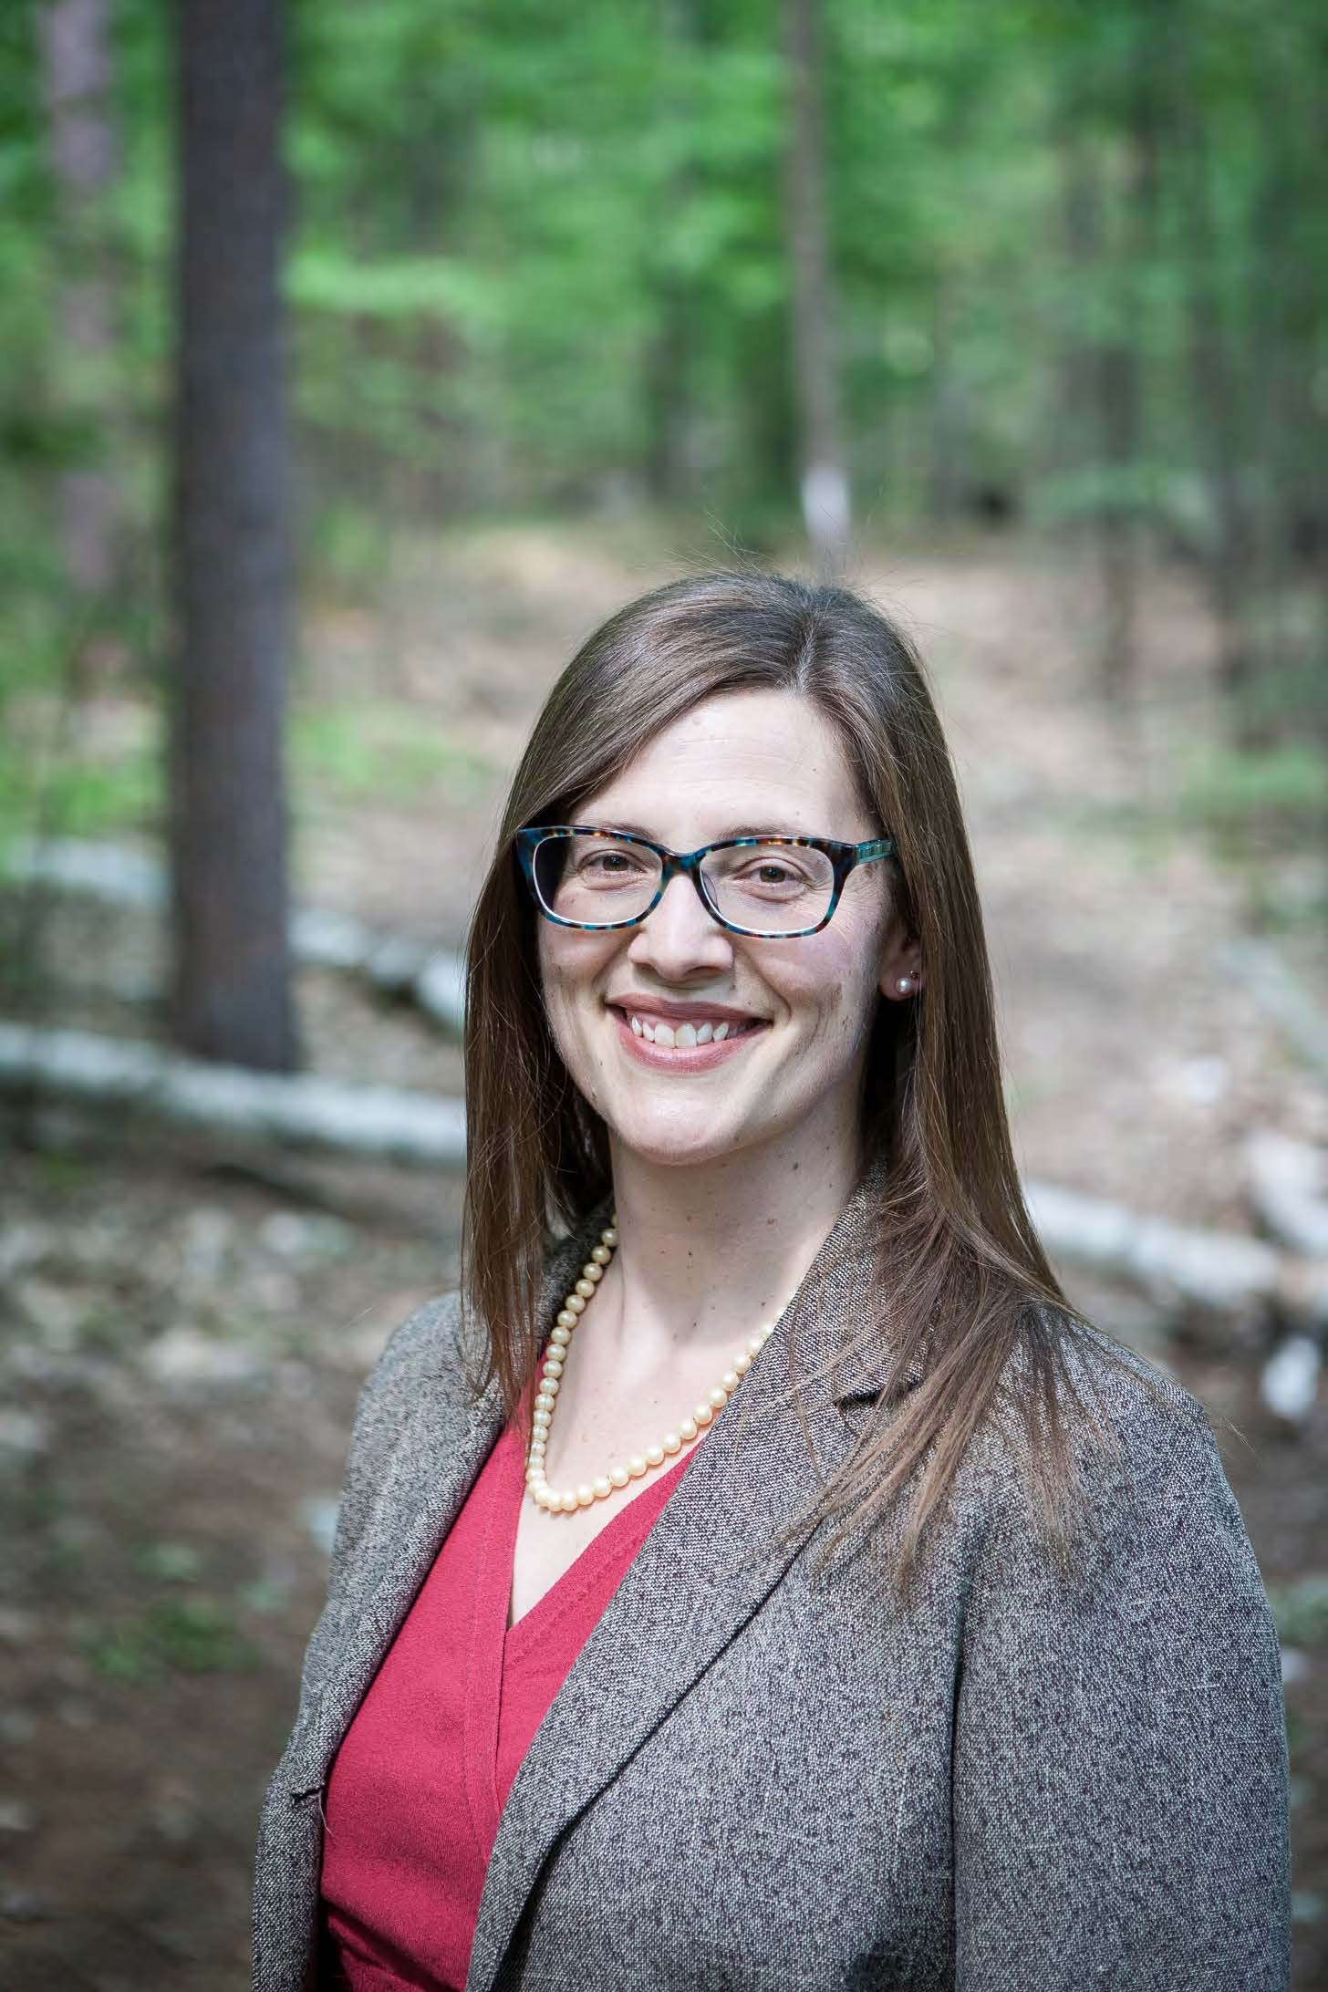
Amy Manzelli, Esq.
BCM Environmental & Land Law, PLLC
manzelli@nhlandlaw.com
(603) 225-2585

Slide 3

Before You Conserve

Slide 4
1. Do Hire a Lawyer
Do your homework first
  Someone you can keep going back to
Early
Often

Slide 5
2. Do Get Friends
NH Land Trust Coalition - nhltc.org
NH Assoc. of Conservation Commissions - nhacc.org
Land Trust Alliance - landtrustalliance.org

Slide 6
3. Do Write It Right (It’s Forever!)
Property Description
Renewable Energy
Hunting
Require Insurance
Reserved Rights - what can landowner do?
Prohibitions
What can Conservation Easement holder do?

Slide 7
4. Do Baseline Documentation
Overall - establishes condition when conserved
Contents
  Maps
  Surveys
  Inventories
  Title documents
  Photos - lots

Slide 8
5. Don’t “Float”
Floating envelope sets area but not location
Originally - creative solution
Now - problematic

Slide 9
After Conservation Easement

Slide 10
6. Do Annual Monitoring
How
  Drones
  Foot
  Vehicle
At least once per calendar year
Review the easement itself beforehand
Create a consistent report template

Slide 11
6. Do Annual Monitoring, Con’t
Benefits
  Protect your property right
  Avoid adverse possession
  Establishment and knowledge of the boundaries
  Establish and maintain your presence on property
  Monitor and maintain any improvements you have installed
  Learn ecological baseline - recognize changes including timbering
  Minimize liability - identify and fix any dangerous conditions

Slide 12
7. Do Document
Everything!
Monitoring
Violations
Communications
Insurance
Note – subject to RSA 91-A, the Right-to-Know Law

Slide 13
8. Do Neighborly Relations with Landowner
Maintain ongoing communication with landowner
Minimum - Annual communication with notice of monitoring, copy of report, discussion, and resolution of any violations

Slide 14
9. Don’t Let Noncompliance Slide
Conservation easements that were partly or wholly donated are “charitable trusts”
Charitable Trust Conservation Easement holders owe three duties when managing conservation easements: Loyalty, Obedience, and Care
Enforcement of violations are part of these duties
Doing nothing could mean breach of duties
  Creates legal liability for the Conservation Easement holder

Slide 15
10. Don’t Amend Unless
Check State Guidance
Confer with State unless crystal clear

Slide 16
Resources
Case Study - N.H. Department of Justice, Report of the Attorney General: Lamprey Field Conservation Easement, https://www.doj.nh.gov/charitable-trusts/documents/north-hampton-conservation0easement.pdf
State Guidance - Amending or Terminating Conservation Easements: Conforming to State Charitable Trust Requirements, https://www.doj.nh.gov/charitable-trusts/documents/conservation-easements-guidelines.pdf

Slide 17


Thank You!
Amy Manzelli, Esq.
manzelli@nhlandlaw.com
(603) 225-2585
QUESTIONS?

